Slide 1
Convolution Neural Network (CNN) II
Bakul Gohel, Ph.D.
DA-IICT, Gandhinagar

Slide 2
ImageNet Challenge

Slide 3
Convolution Neural Network
Different popular architectures of CNN
VGG
GoogleNet
RestNet
DenseNet

Slide 4
Different Architectures

Slide 5
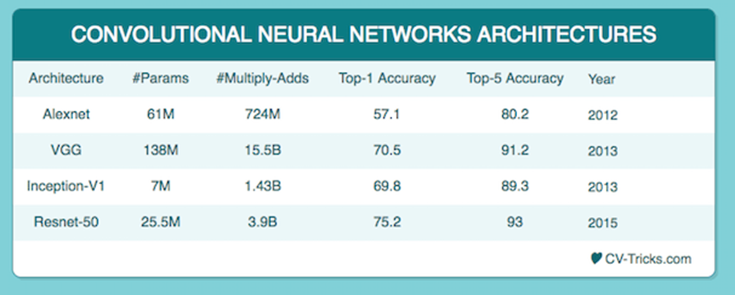

Slide 6
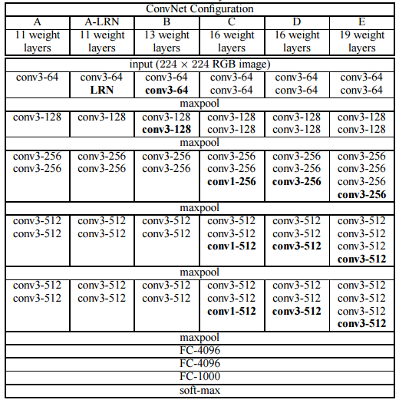
VGG Group at Oxford (2013)
Standard CNN with more Convolutional Layers…

Slide 7
GoogleNet (2014)
Deeper is the Network better is the performance
Auxiliary Output
To minimize vanishing gradient issue
Different filter/kernel size
Considering the feature at different scale simultaneously
1X1 convolution to control depth of the tensor

Slide 8
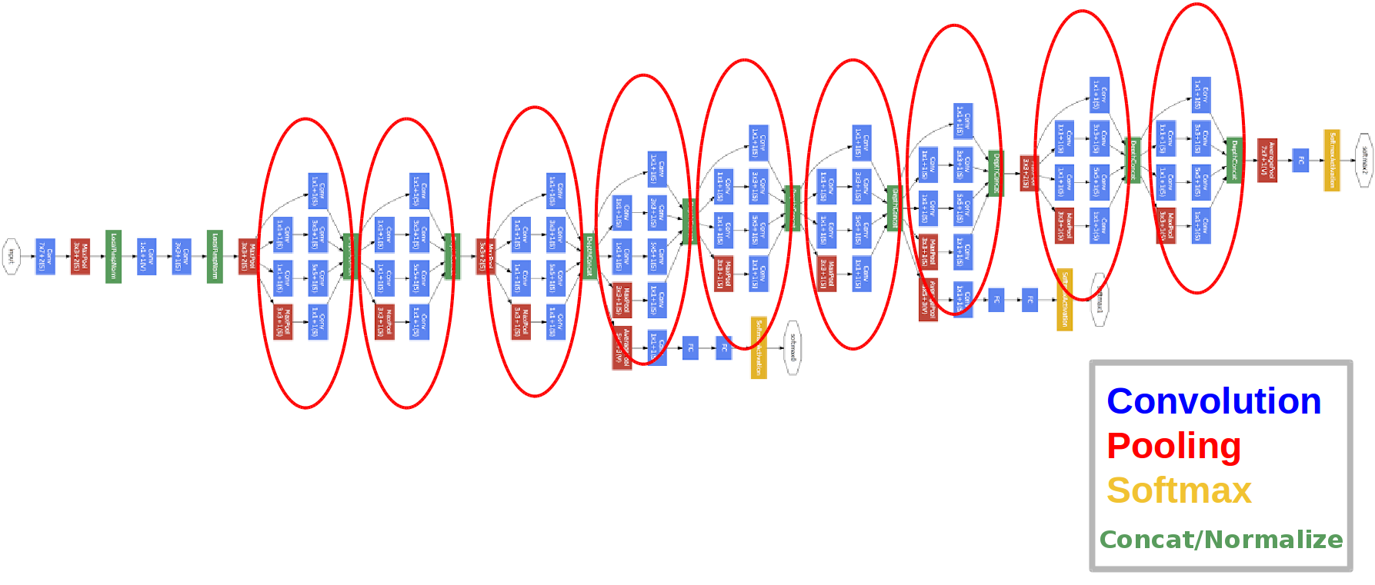
GoogLeNet (2014)
Auxiliary Output/loss
(weight it lower than main output)

Slide 9
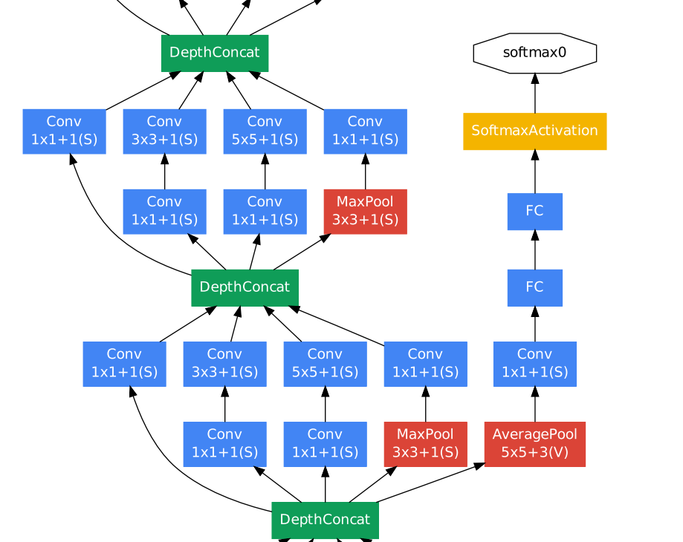
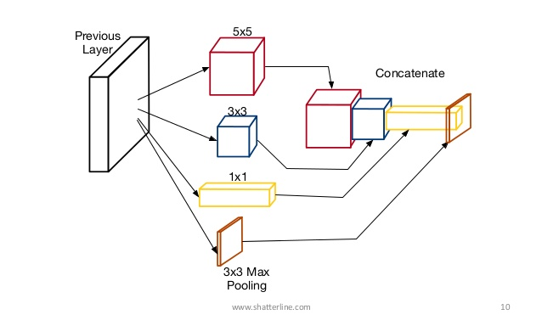
GoogLeNet (2014)

Slide 10
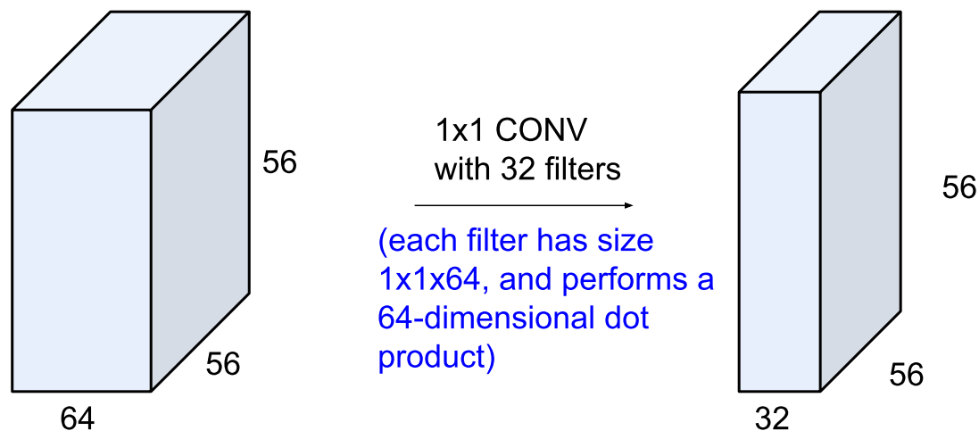
1X1 convolution operation
1X1 CONVOLUTION ; to control the depth of the activation map/features

Slide 11
ResNet (2015)
Deeper is the Network better is the performance, But…
too deeper, there is network degradation and vanishing gradient issue…

Slide 12
ResNet (2015)
Solution…Skip connection
is the residual of
Learning residual is easier…!!! Learn depth as per requirement…!!!
Skip connection reduces effective depth of the network so minimizes the vanishing gradient issue…

Slide 13
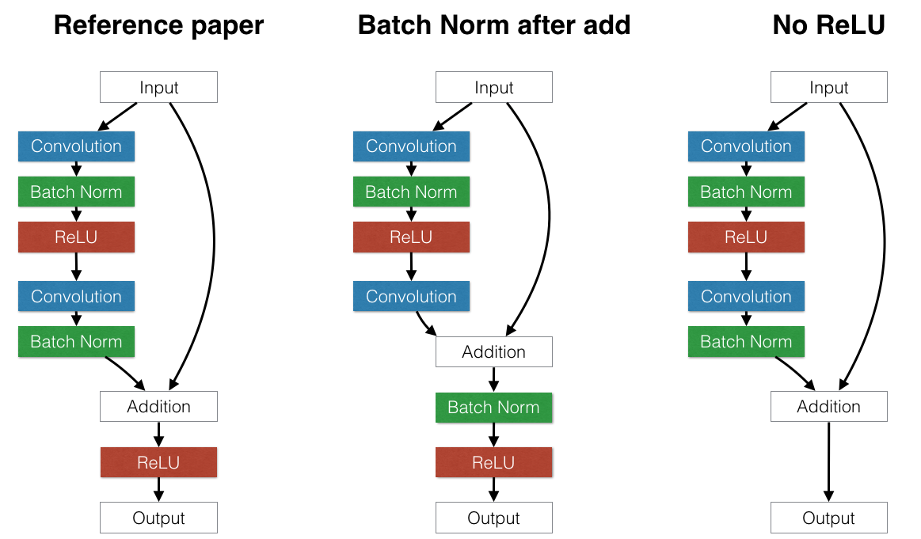
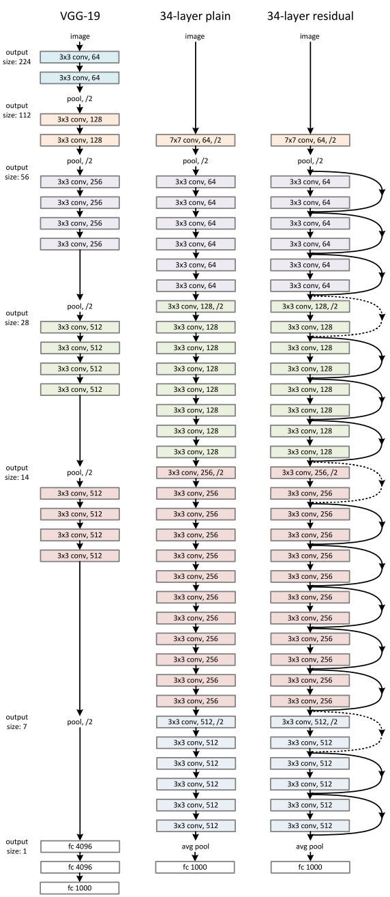
ResNet (2015)
You need to take care of tensor size at addition point to implement skip connection

Slide 14
ResNet (2015)
Results on CIFAR-10 dataset

Slide 15
Dense Net
Maintenance of low complexity features along with higher order features in the hierarchy
Low complexity Features

Slide 16
Dense Net
Maintenance of low complexity features along with higher order features in the hierarchy
Low complexity Features
skip connections…addition in ResNet while concatenation in Dense Net

Slide 17
Dense Net
Maintenance of low complexity features along with higher order features in the hierarchy
Effective against vanishing gradient issue as gradient flow through skip connections…

Slide 18
Dense Net
CIFAR-100 dataset

Slide 19
Take away messages
Deeper is the Network better is the performance
Higher level features improve the performance, but…
Need to tackle vanishing gradient problem
Overfitting
Auxiliary Output (googleNet)
Minimizes the vanishing gradient issue
Skip Connections (ResNert)
Network to decide depth of useful features
Minimizes the vanishing gradient issue
Maintaining low complexity features in the deeper layer (DenseNet)
Network to decide depth of useful features
Minimizes the vanishing gradient issue

Slide 20
Take away messages
Designing or modifying CNN architecture
Pay attention to input/output tensor size to implement concepts from above mentioned architectures
Convolution same vs valid
Pay attention while using pooling layers
1X1 convolution kernel to control the depth of feature map
Pay attention to number of parameter between layers ; should not too much shrinkage and expansion of the information flow

Slide 21
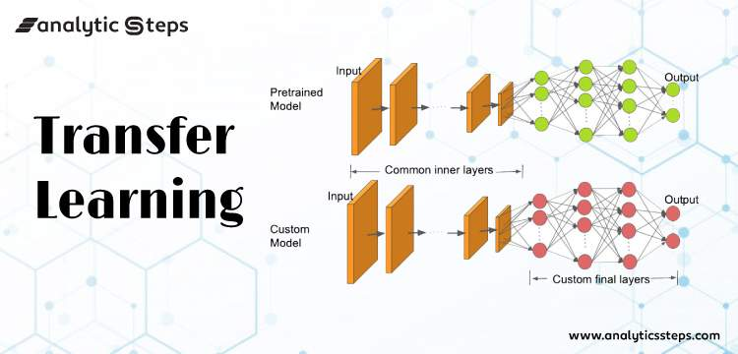
Transfer Learning

Slide 22
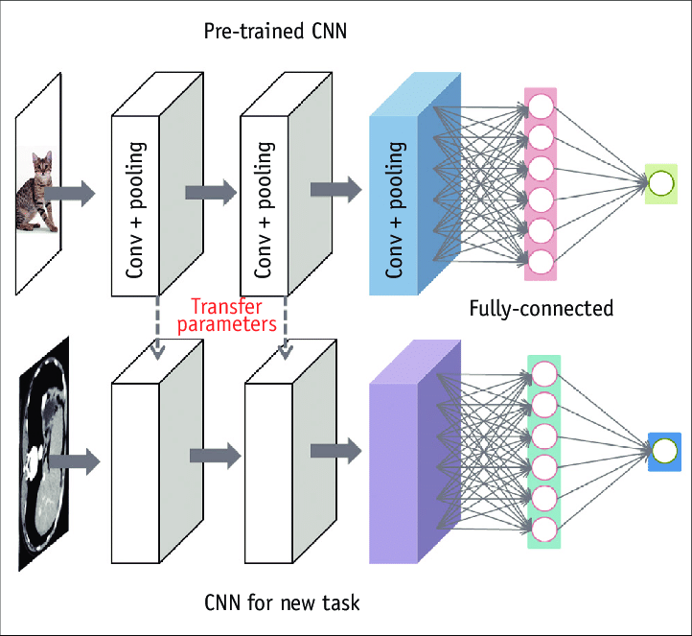
Transfer Learning

Slide 23
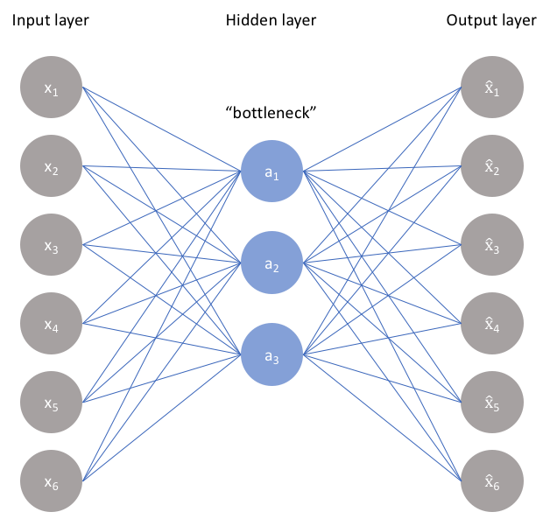

Auto-encoder
X’= g(f(X)), X=X’
Z = encoder(X), X’=decoder(Z). X=X’
Minimize L(X,X’)

Slide 24
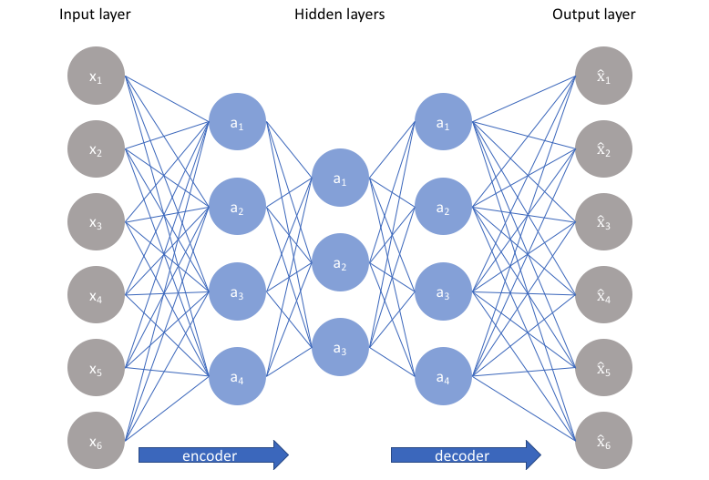
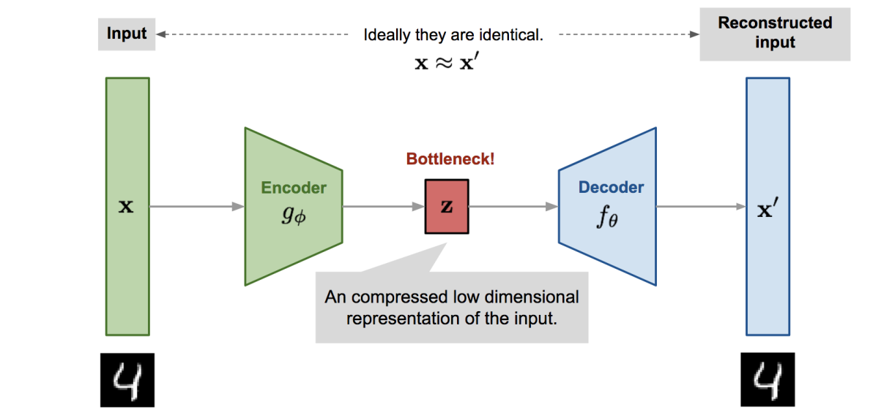
Auto-encoder
Bottleneck forcing learn to compressed code of input data;

Slide 25
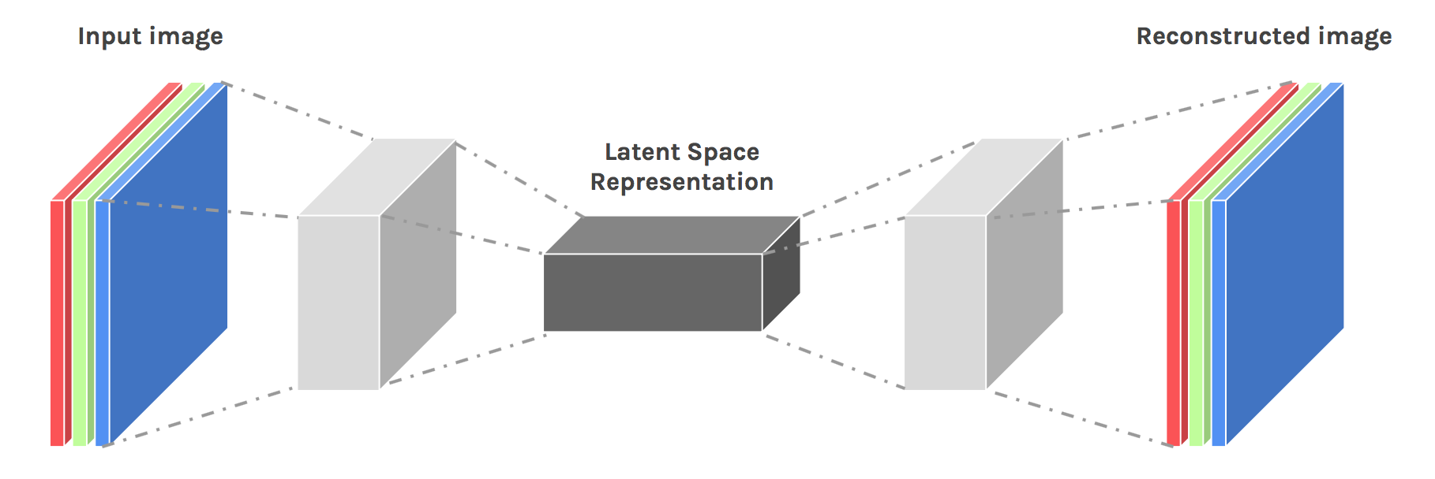

Auto Encoder

Slide 26
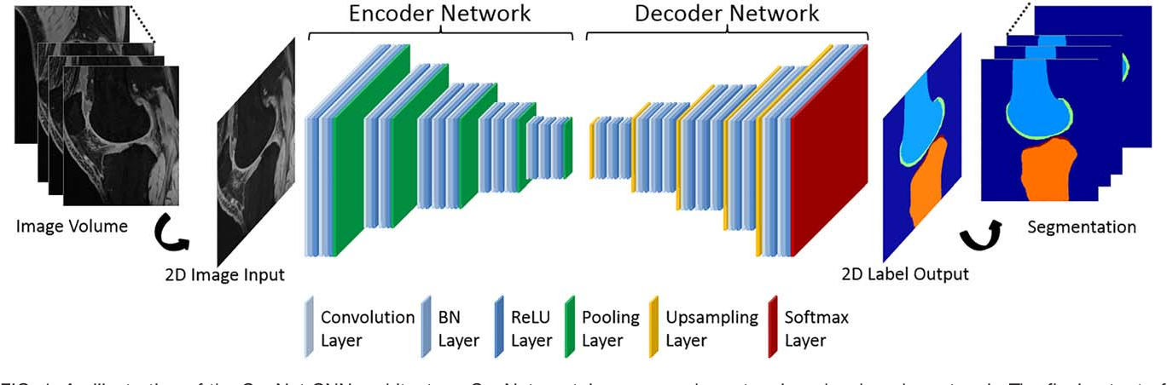
Image Segmentation + CNN

Slide 27
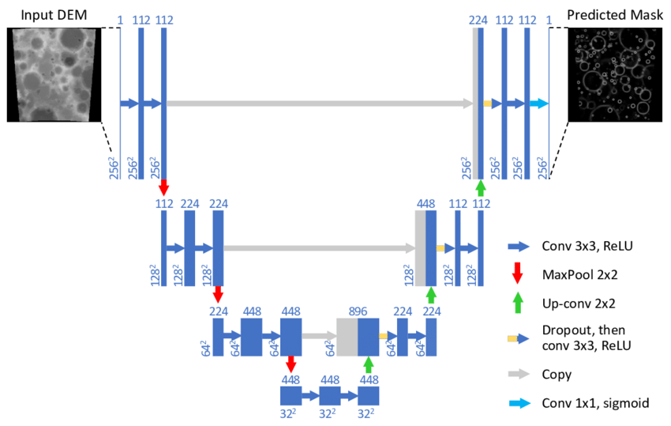
U-Net architecture
Skip connections
Skip connections

Slide 28
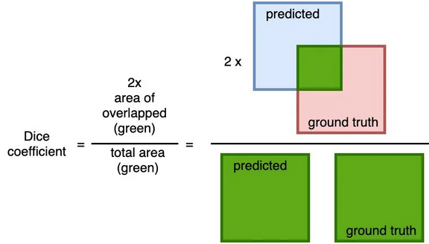
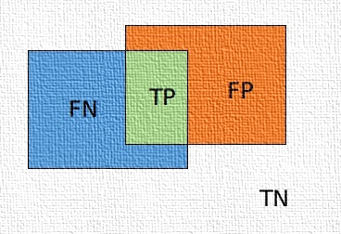
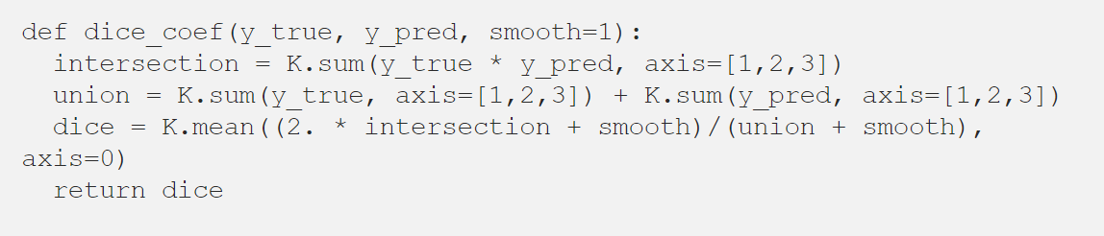
DICE Coefficient
DICE Loss = 1 - DICE Coefficient (f1-score)

Slide 29
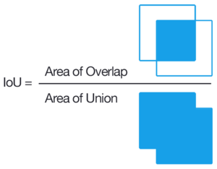
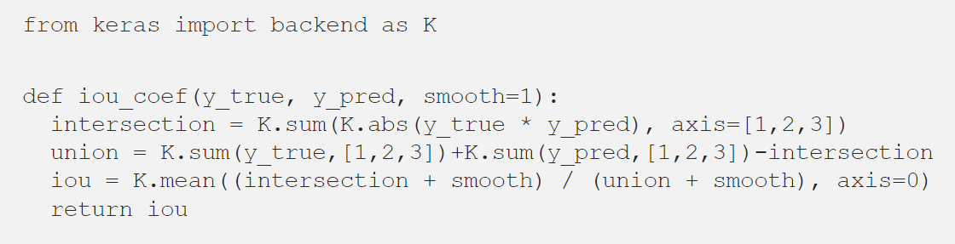
Intersection over Union (IoU)
Jaccard Index

